Slide 1
Empirical Analysis of the German Caselaw on SEP Injunctions after Huawei v ZTE
Dr. Justus A. Baron
Northwestern University & BRELA Bureau d’Etudes

Slide 2
Introduction
Important technology standards such as 5G, WiFi 6, and HEVC are subject to Standard-Essential Patents (SEPs) owned by various firms.
Disputes over SEP licenses may lead to litigation in different national court systems worldwide.
Two global approaches have emerged: determining Fair, Reasonable, and Non-Discriminatory (FRAND) royalty rates and/or awards of injunctive relief
Differences in court approaches create friction and parallel litigations.
In some countries like the US, Japan, and Korea, obtaining injunctive relief for SEP owners is challenging.
However, SEP injunctions still occur in jurisdictions like Germany, the Netherlands, and China; with Germany being the most common venue.

Slide 3
Introduction
The European Court of Justice's (ECJ) Huawei v ZTE decision creates a framework for assessing permissibility of requests for injunctive relief
German courts have referenced and applied this framework, though interpretations vary.
Recent attention to SEP litigation in Germany has influenced EU policy
Proposed regulation purports to increase consistency and reduce litigation
Intervention by EU Commission in ongoing litigation at Munich regional court
Importance of German caselaw for Unified Patent Court (UPC) jurisprudence

Slide 4
Literature
Numerous legal analyses of specific court decisions or specific points of law
Emphasis on higher instances, in particular Federal Court of Justice in Sisvel v Haier
Summaries of German jurisprudence, based on overviews over smaller numbers of cases:
Gniadek (2016), Pentheroudakis and Baron (2017), Nolte and Rosenblum (2017), Tapia and Markis (2018), Picht (2019), Colangelo and Aguggia (2023)
Detailed legal analysis of a large number of decisions by Habich (2021), by points of law (in German, study period 2015-2019)
Empirical studies of German caselaw more limited
Older studies focused on validity/infringement outcomes (Contreras et al., 2017)
Baron et al. (2023) coded 23 court decisions with respect to timing of dispute
Lack of recent empirical studies on FRAND decisions in Germany, which would be comparable to studies of US decisions by Lemley and Simcoe (2021) or Helmers and Love (2023, 2024)

Slide 5
This study
Comprehensive empirical analysis of German caselaw on SEP injunctions
Coded 71 regional court decisions in cases involving FRAND defenses and injunction requests.
Focus on the frequency of certain outcomes:
success of FRAND defenses in German courts, reasons for SEP holders or implementers prevailing, and factors influencing litigation outcomes.
Identified related parallel validity proceedings at Federal patent court, and subsequent higher instance decisions (appeals)
Our findings highlight a balanced caselaw, but also underscore concerns such as bifurcation and limited reviews of FRAND compliance.

Slide 6
Methodology
Sample Selection
First instance (Landgericht) court decisions decided after Huawei v ZTE, where
patent is infringed and essential to a standard, and subject to FRAND commitment and plaintiff's injunction request.
Data sources: Court websites, law firm databases, darts-ip
Coding of Decisions
Case number, court, decision on injunction, dates of relevant events, and amount in dispute.
Identified key data from findings of fact (Tatbestand):
dates in dispute (date of first contact, patent holder’s first licensing offer, complaint, and request for injunction)
Characteristics of patent holder's licensing offers: Pool licensing and worldwide portfolio license offers.
Coded courts’ legal analysis (Entscheidungsgruende) under Huawei v ZTE:
Existence of a dominant position
Abuse of dominant position
Sufficient notice of infringement,
Willingness to license
FRAND offer (formally and substantively).
Searched for further legal proceedings:
Occurrence and outcomes of appeals
Parallel validity proceedings

Slide 7
Descriptive analysis

Slide 9
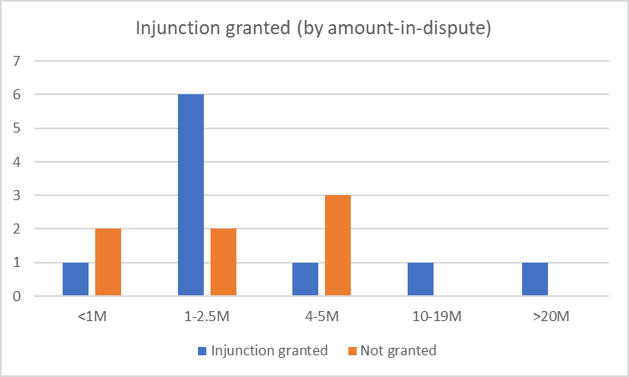

Slide 18
Discussion and takeaways
Balanced Reality:
Post-Huawei v ZTE, German courts exhibit balanced approach in SEP litigation.
Both SEP holders and implementers have similar success rates in FRAND defenses.
No indication of injunction likelihood correlating with the amount in dispute.
Valid Concerns:
Courts engage superficially with substance of FRAND offers.
Bifurcation of proceedings between validity and infringement raises concerns; many injunctions issued for later invalidated patents.
Areas for Improvement:
Disproportionate focus on individual patent validity over substantive FRAND character of offers.
Need for efficient, comprehensive resolution of disputes beyond narrow patent validity focus.

